Slide 1
Omnichannel VoiceBot Team
Booz Allen Research Pulse Update
September TBD, 2022

Slide 2
Agenda
What do we want to show…
Data

Slide 3
Claims Data that the VoiceBot Will Use
Data We ‘Hope to Provide to Vets
Data We Can Provide to Vet
Data We Hope to Create for Vets Custom Data
Source: X - Status Title EX) Initial Review
Review

Slide 4
Research on Claims Data/Information
What we hope to learn:
- Understand claims issues - Understand how claims agents talk to Vets about claims - Understand Veterans vernacular language regarding claims - Understand how Vets are posing questions/words their - What info will better satisfy Vets call questions RE: claims (to reduce calls, etc)
Purpose:
Train the VoiceBot sentiment analysis
Use API data calls appropriately
Prepare custom responses for VoiceBot to deliver to Vets
Only send complex cases to agent reduce non complex calls

Slide 5
Project Overview
Detailed scope for Omnichannel project will be voice.
Discovery through building and learning—build it, learn from it, iterate it.
With an overall strategy of transitioning MyVA411, transition VBA to using a Natural Language Understanding (NLU) platform.
Determine the problem categories and point of transition.
Through learning and understanding how self-service and triage can be supported through voice channels, assess another product which may replace AudioCARE.
Stipulations:
Projects must have a customer experience and Omnichannel mindset toward best customer experience for Veterans.
Small iterative releases, solutions to run in parallel with existing solutions to Veterans are not negatively affected by our transitions.
All products must have Veteran input.

Slide 6
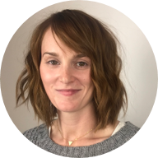
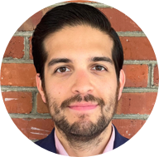
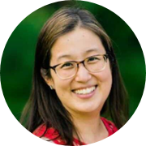
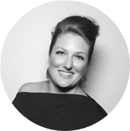
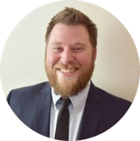

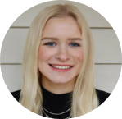
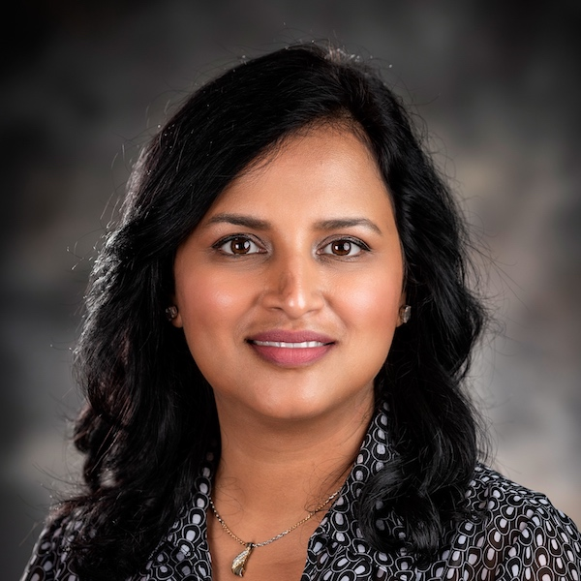
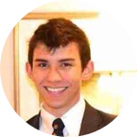
Project Team
Sara Snead
Program Manager
Gian Bustillo
Project Manager
Kateleigh Clark
Project Advisor
Julie Naga
UX Lead
Ray Walther
Cognitive Solutions & Technology Lead
Filip Fafara
Technical Advisor
Grace Goodenough
Project Scheduler
Sunayna Goel
Business Analyst
Patrick Onesty
Technical Writer

